Slide 1
LearnIt AI
Authored by Sahil Dadhwal, Vicky Kang, Mai Westfall
Notes:
https://docs.google.com/document/d/1Jx5clHeZqgT8vPL_vnf2eeH2Bf9ewOHEvYCKua4jG4w/edit?usp=sharing

Slide 2
33 Percent
of first-generation students drop out
Source: NCES

Slide 3
Financial Aid
Daycare
Colleges offer assistance…
Counselors
But is that enough..?

Slide 4

Anna
lost her scholarship

Slide 5
LearnIt AI
Supporting students' success

Slide 6
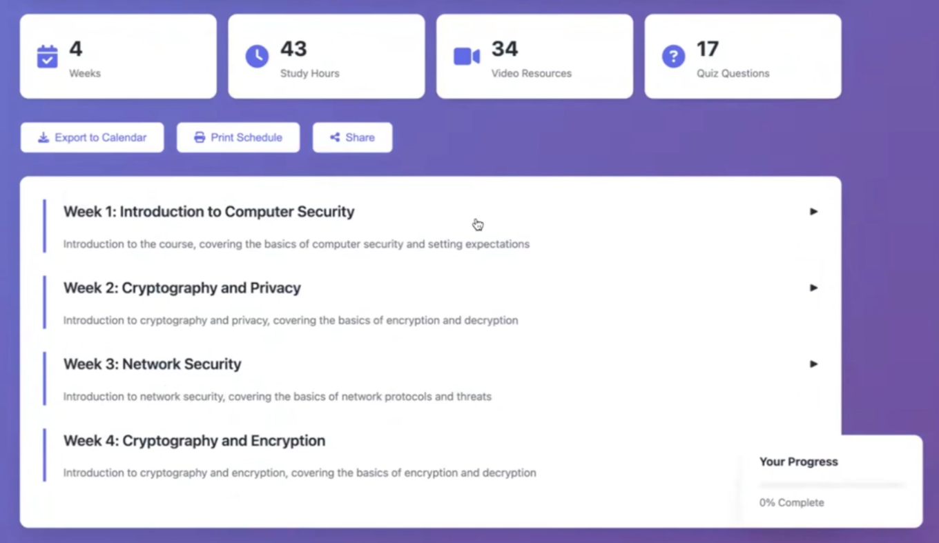
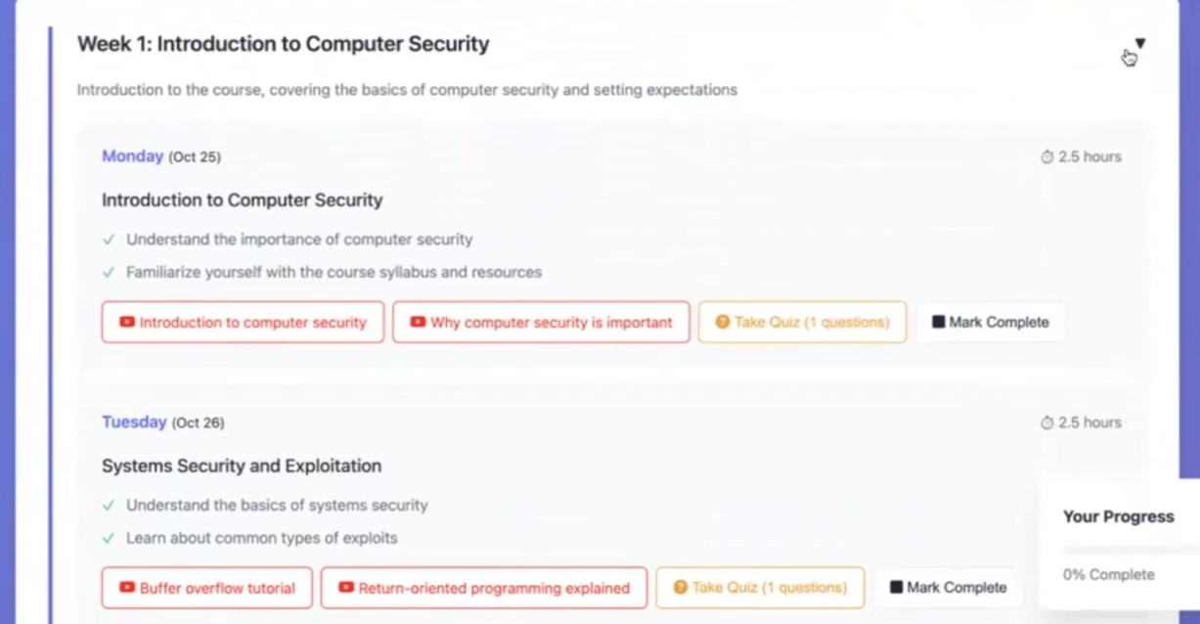


LearnIt AI
Smart Schedule Generation
Week by week:
Daily breakdown
Youtube resources
Review and quizzes

Slide 7
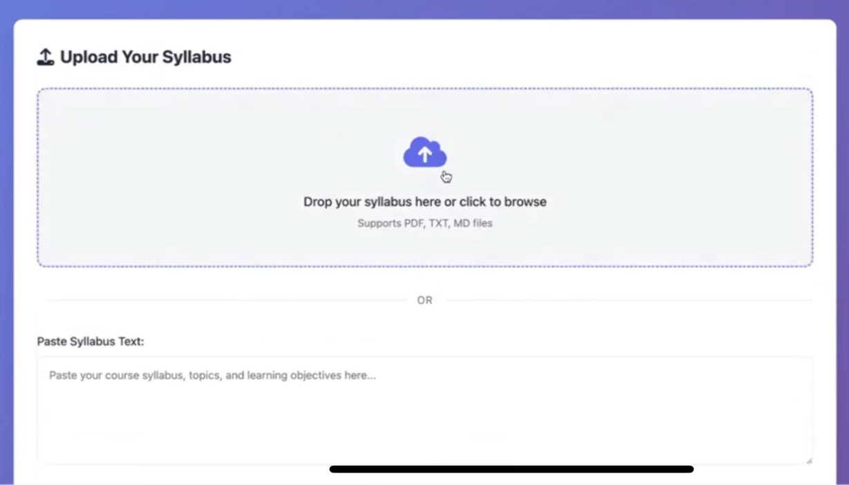

Simple to Start
Works on multiple devices
File & paste support
Copy, export, or print your schedule
For any student, at any time

Slide 8


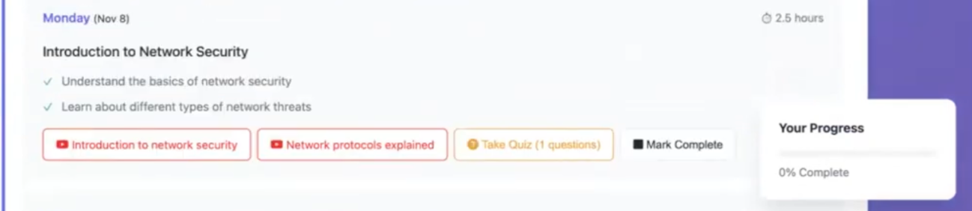
Keeps Motivation
Exports in calendar apps
Tracks and saves progress
Instant feedback & explanations

Slide 9
Future Direction
Collaborative study groups
AI tutoring chatbot
Study streak gamification
Custom study intensity levels
Flashcard generation

Slide 10
Assisting students
along their journey

Slide 11
Thank You!

Slide 12
Appendix

Slide 13
Architecture
Upload Syllabus PDF/TXT or Paste Text
Set Preferences
Course Duration
Start Date
User Starts
Click Generate
Create Study Schedule
Weekly Topics
Daily Objectives
Study Hours
Add Resources
Youtube Videos
Quiz Question
AI Processing
Groq Llama 3.3
Take Quizzes
Display Interactive Schedule
Track Progress
User Features
Export Calendar
Watch Videos

